Slide 1
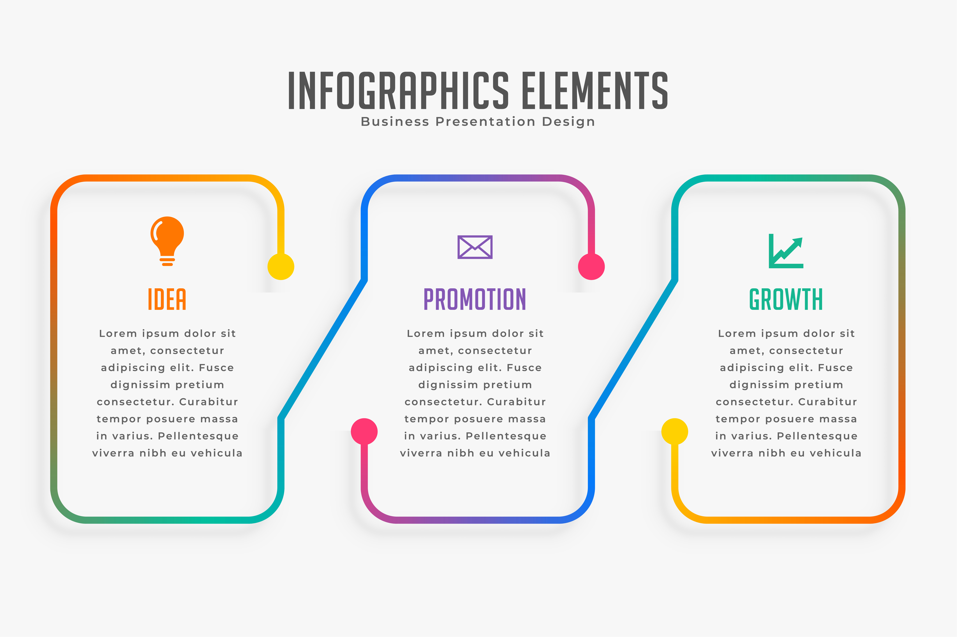



Sustainable Development Goals - SDGs
Sustainable cities and communication
Life on land
Good health and well-being
Using public transportation instead of private car to reduce Carbondioxide
Planting tree or plant help us to increase Oxygen and reduce Cabondioxide. Some animal use tree as home, more tree more home for them
Blood donating is one of the way to help each other who need blood replacement to have a better health

